Slide 1
Green Screen Locations
Group Photo Locations
Tech Station Locations
Retail Station Locations

Slide 2
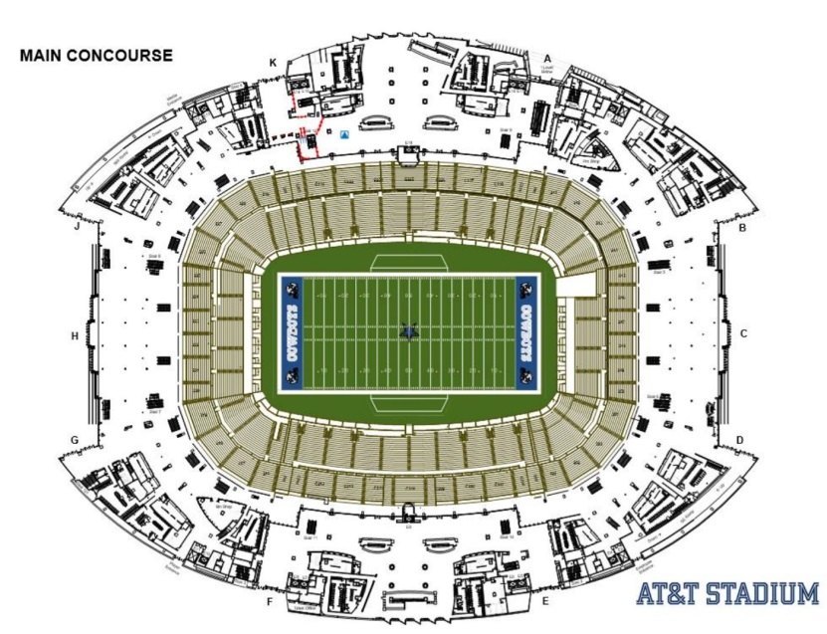
Tour Routes (standard)
MAIN
CONCOURSE

Slide 3
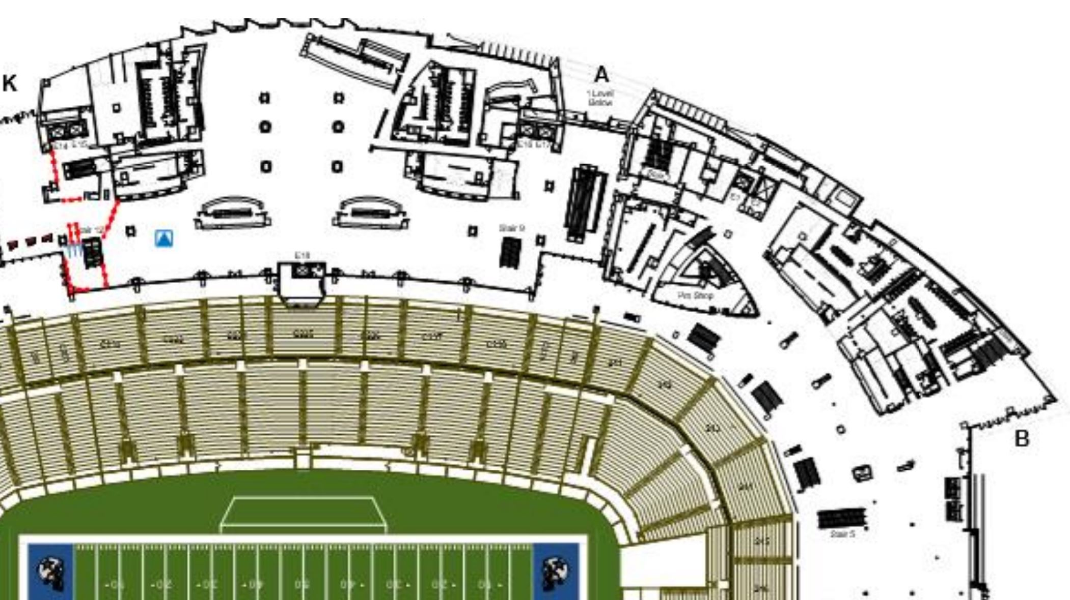
Tour Routes (standard)
MAIN
CONCOURSE

Slide 4





Tour Routes (standard)
MAIN
CONCOURSE
Entry A Guest arrival
NW
GAP
NE GAP
Guest
Waiting

Slide 5
Main Concourse Standard Routes
MAIN
CONCOURSE
Entry A Guest arrival
RYANS
CLUB
(we are not allowed to use)
Ryans
Club
(we use)
NE
GAP
NE GAP
Guest
Waiting
(side of) EAST CONCOURSE
(We are allowed to use w/ approval)
EAST
CONCOURSE

Slide 6
Green Screen Locations
MAIN
CONCOURSE
Entry A Guest arrival
RYANS
CLUB
A
NW
GAP
NE GAP
Guest
Waiting
B/C
D
(side of) EAST CONCOURSE
EAST
CONCOURSE

Slide 7
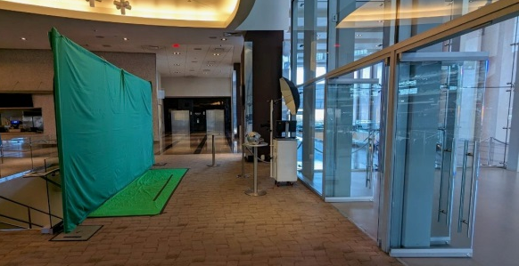
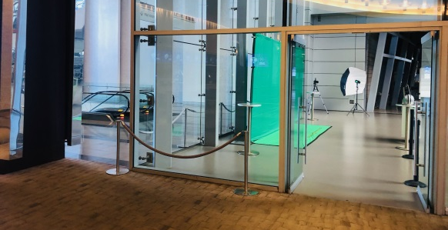
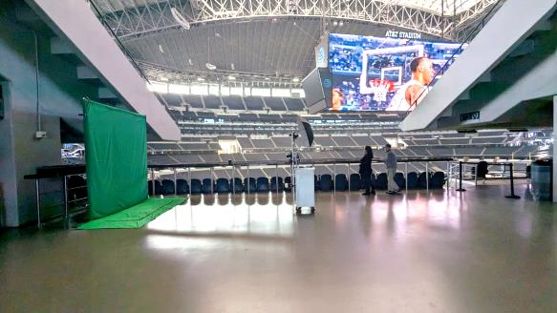
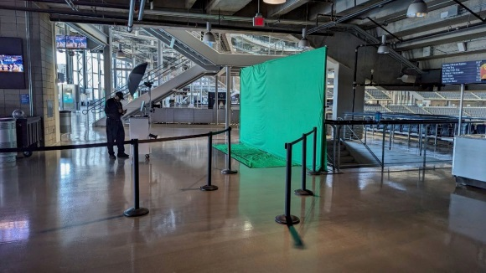
Green Screen Locations
MAIN
CONCOURSE
A
B
C
A
B
C
D
D

Slide 8
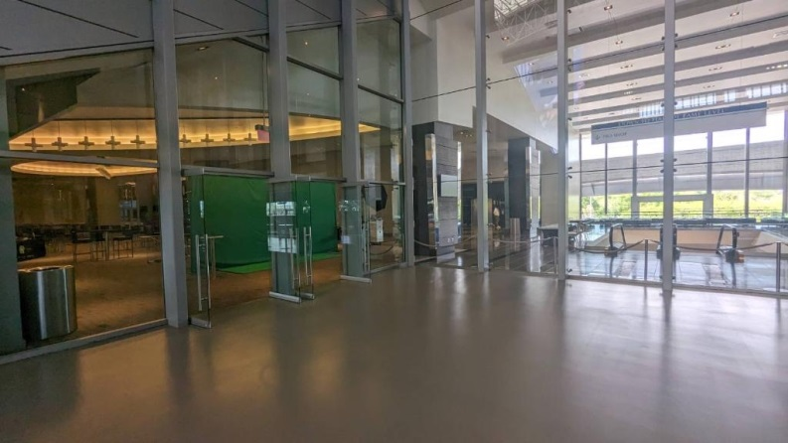
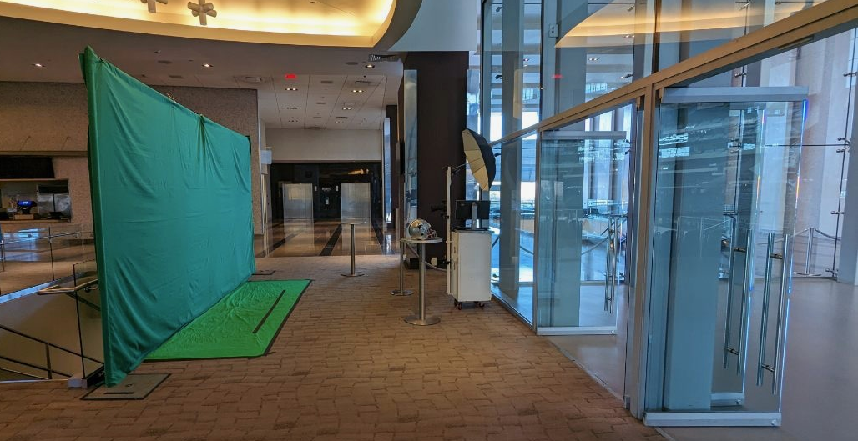

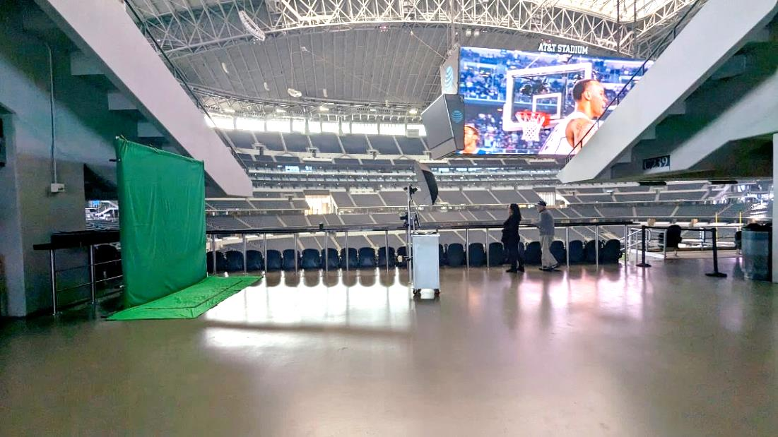

Green Screen Locations
A
B
C
D

Slide 9
Green Screen Locations
A
[Site A]
‘Ryans Club’
“Main Club North”
NE GAP
Guest
Waiting
PROS
Excellent Customer Funneling.
No customer distractions.
Bright Area, where lighting is controlled.
Close proximity to Jowdy Photo/Tech&/Retail stations (requires less Jowdy personel).
Establishes a start & end point of the tour.
(clear to the tour guides where to return, reduces bypass & no-show; customer return
increased).
Cons
Requires moving often.
(Catering books the partial or full space often.)
RYANS CLUB
A
NE
GAP

Slide 10
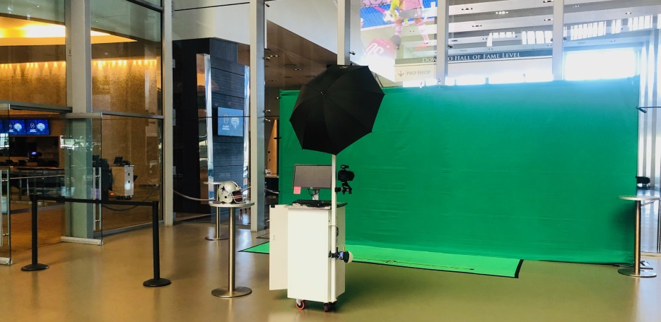
Green Screen N-NE Gap
B
NE GAP
Guest
Waiting
PROS
Good Customer Funneling.
Falls in line w standard Legends tour plan.
(reduces photo op bypass
RYANS CLUB
Cons
Customers distracted by the field/initial awe of stadium.
Ambient light changes w time of day & weather.
Ambient Noisefrequently high & interfering.
Requires moving often.
Limited communication with Tech/retail, requires more personel. (especially if in HoF, phone calls are required to request backup.
Increased bypass on the redemption side
B
NE
GAP

Slide 11
Alternative Tour Routes (Scenario 1)
MAIN
CONCOURSE
Entry A Guest arrival
RYANS
CLUB
NW
GAP
NE GAP
Guest
Waiting
B/C
(side of) EAST CONCOURSE
EAST
CONCOURSE

Slide 12
Alternative Tour Routes (Scenario 1)
MAIN
CONCOURSE
Reality bypass NE-gap
Entry A Guest arrival
RYANS
CLUB
NW
GAP
NE GAP
Guest
Waiting
B/C
(side of) EAST CONCOURSE
EAST
CONCOURSE

Slide 13
Green Screen Locations
MAIN
CONCOURSE
A
B
C
D
D

Slide 14
Green Screen Locations
D
Cons
PROS
NE
GAP
D

Slide 15
Alternative Tour Routes (Scenario 2)
MAIN
CONCOURSE
Entry A Guest arrival
RYANS
CLUB
On HoF level
NW
GAP
NE GAP
Guest
Waiting
(side of) EAST CONCOURSE
EAST
CONCOURSE

Slide 16
Alternative Green Screen Locations
Optum Club
Cons
PROS
NE
GAP
D

Slide 17
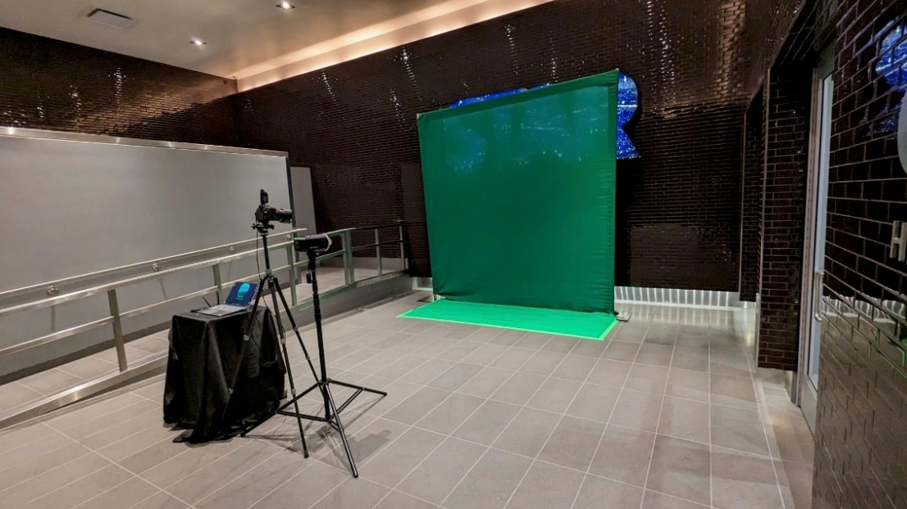
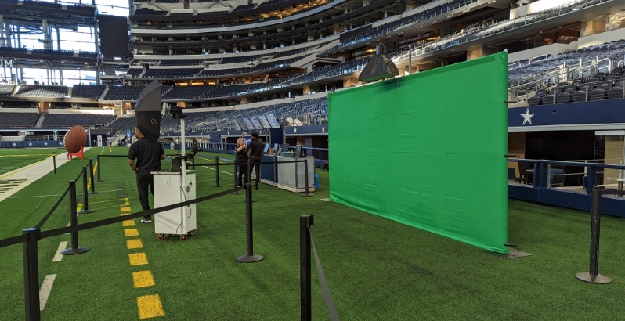

Slide 18
Green Screen Locations
MAIN
CONCOURSE
A
B
C
D

Slide 19
Green Screen Locations
MAIN
CONCOURSE
Entry A Guest arrival
RYANS
CLUB
A
NW
GAP
NE GAP
Guest
Waiting
C
(side of) EAST CONCOURSE
EAST
CONCOURSE

Slide 20
Green Screen Locations
MAIN
CONCOURSE
RYANS
CLUB
NW
GAP

Slide 21


Slide 22
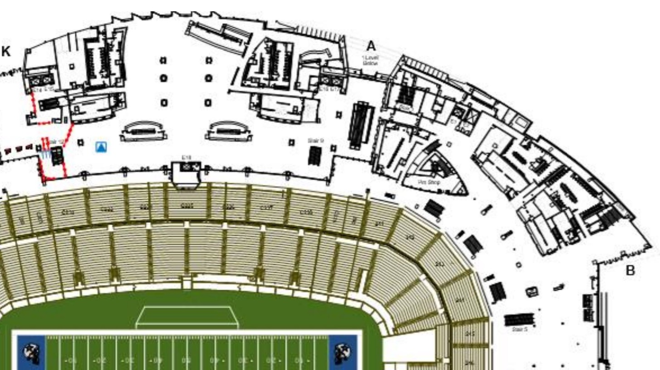
Green Screen Locations

