Slide 1
New BACKUP LOCATION for Original & Rastered Files at ‘Close-out’
OLD (do not use): AT&T Stadium Main Storage → 01 AT&T Stadium → 2024 → 01 Tours → 10 Rasters → 01 Jan → 2024.01.17
New (use this): AT&T Stadium Main Storage → 01 AT&T Stadium → 2024 → 01 Tours → 00 Photos → 01 Jan → 2024.01.17

Slide 2
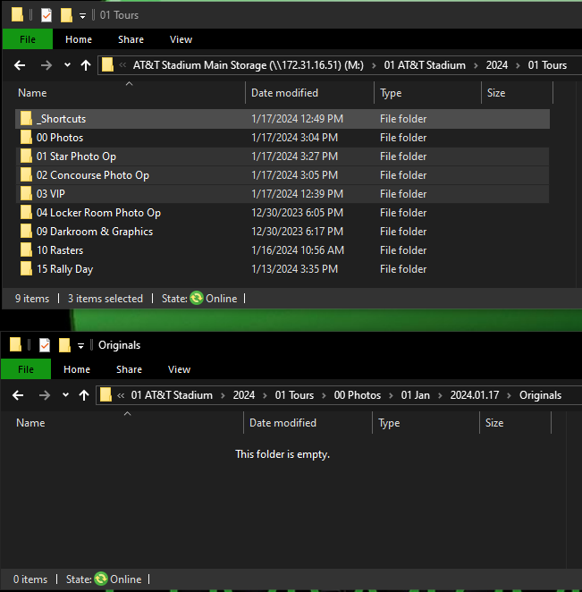
New BACKUP LOCATION for Original & Rastered Files at ‘Close-out’
OLD (do not use): AT&T Stadium Main Storage → 01 AT&T Stadium → 2024 → 01 Tours → 10 Rasters → 01 Jan → 2024.01.17
New (use this): AT&T Stadium Main Storage → 01 AT&T Stadium → 2024 → 01 Tours → 00 Photos → 01 Jan → 2024.01.17
Originals → In the Tours folder → select the photo op folders used today.
Hit ‘Ctrl + c’
→ Select the new Originals Backup folder Window
Hit ‘Ctrl + v’
Rasters → In the Tours folder → Open the 10 Rasters folder.
Hit ‘Ctrl + a’, then ‘Ctrl + c’
→ Select the new Originals Backup folder Window
Copy the folders to the Backup location

