Slide 1
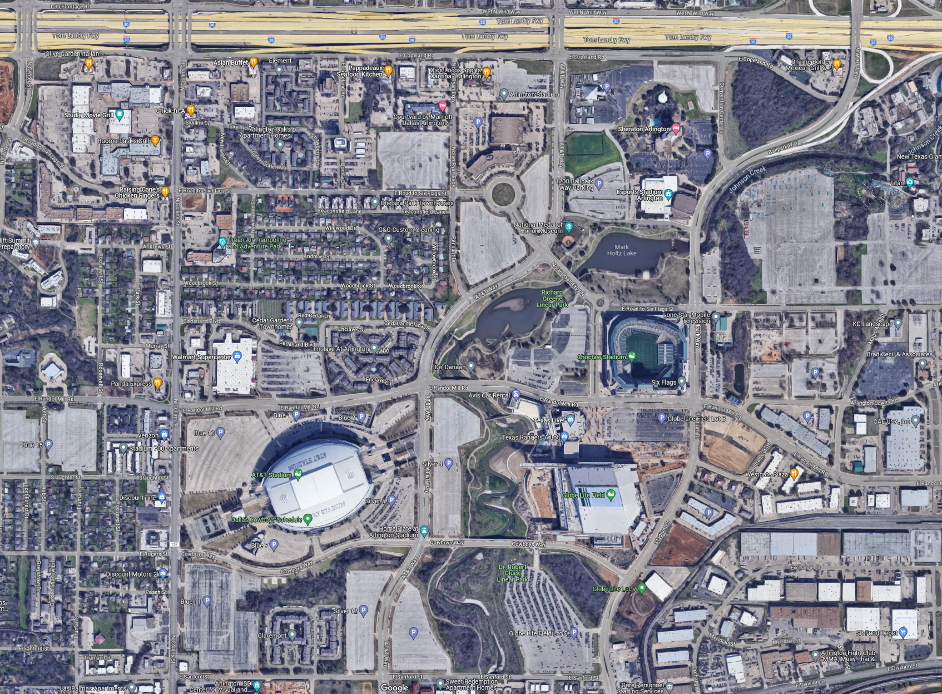




Parade Route
Usual Parking
Silver lot 5
*Do NOT Park Here*
PARK HERE
Blue Lot 7
EMPLOYEE ENTRANCE

