Slide 1

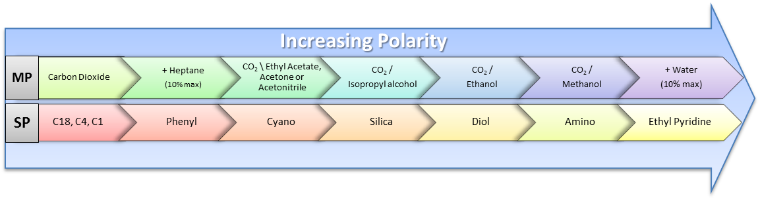
Leiden Universiteit | Metabolomics Facility | Natural Products Laboratory (NPL)
SFC Quick Reference Guide
SFC Quick Guide
SFC Quick Guide
SFC Quick Checklist
Before Use | Instrument Log
 | Calculate & Prepare Modifier | Ex. solvent needed = RunTime + 0.5min * Flow * SMP# * INJ# + 100mL * Average % A
 | Filter Samples | 0.20 µm filter (in Fume hood 1).
 | Check Waste | Max Fill = 75% capacity CO2 Waste Line >> Hood!
Before Running a Sequence | Transfer Solvent Lines | Be mindful of glass filters & to not splash or spill.
 | Turn On the Instrument | Switch each module on; then open chemstation. “Upload from Instrument”
 | Stop the Pump! | Binary Pump panel > 0.00 ml/min
 | Standby SFC | SFC panel > “Control” > “Standby”
 | Set Solvent Bottle Fillings | Solvent Bottles panel > Total Vol = bottle size; Actual Vol = amount in bottle
 | Purge Modifier Line | ! Purge Valve Open ! @ 5ml/min; 100% B [3-5 min]; ! then Close Purge !
 | Turn On SFC | ! Chiller Below – 5.0 ºC ! SFC panel > “Control” > “On”
 | Turn On Pump | ! Booster Above 70 bar ! Binary Pump panel > “Method” > ‘flow’ = 3.000 ml/min ! Mind the Flow Rate! See table 1 (below) for typical SFC flow rates (ex. ~3ml/min).
 | Injector Wash | SFC panel > “Injector Wash” >> 30 sec (repeat 3x)
 | Load/Create Method | ! Mind the Flow Rate ! See table 1 (below) for typical SFC flow rates (ex. ~3ml/min).
 | Load/Create Sequence Table | Tip: Set ‘sequence parameters’: data storage & SHUTDOWN.mac
 | Run the Sequence | ! Never Save over another method ! (“Method Changed. Save Changes?” = No)
After Running a Sequence | Flush Column Immediately | ! Mind the Flow Rate! ! Purge CLOSED ! using flush solvent; @ ~3ml/min*; 15 min
 | Transfer Solvent Lines to Flush | Be mindful of glass filters & to not splash or spill.
 | Flush Solvent Lines ASAP | ! Purge Valve Open ! @ 5ml/min; 100% [3-5 min/each]; ! then Close Purge !
 | Turn Off the Instrument | Turn off instrument, close Chemstation, then switch off each module.
 | Store the Column | With end fittings installed > below SFC.
 | Clean Up | Discard unused MP, take empty bottles > dishwasher (3.4.03)
 | Take your Samples with you. | After 7 days, Abandoned samples will be discarded.
Increasing Polarity
MP
CO₂
CO₂ / EtAOc
ACE or ACN
CO2 / IPA
+ Heptane (10% max)
CO2 / EtOH
CO2 / MeOH
+ H20 (10% max)
SP
C18, C4, C1
Cyano
Silica
Phenyl
Diol
Amino
Ethyl Pyridine
Table 1. Column Info
Particle Size (µm) | 1.7 | 2.6 |  |  | 3.0 |  |  | 5.0 |  |  | 10.0
ID (mm) | 2.1 | 2.1 | 3.0 | 4.6 | 2.0 | 3.0 | 4.6 | 2.0 | 3.0 | 4.6 | 10.0
SFC Typical Flow (ml/min) | 1.25 | 0.75 | 3.00 | 5.00 | 0.75 | 1.25 | 3.00 | 0.75 | 2.00 | 3.00 | 20.00
Questions, Concerns, Need Training? Please contact Lab manager b.k.berger@biology.leidenuniv.nl

Slide 2

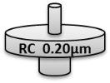







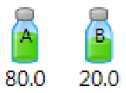




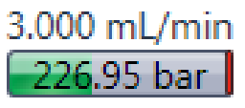






Leiden Universiteit | Metabolomics Facility | Natural Products Laboratory (NPL)
HPLC Quick Reference Guide
Before Using the SFC
Log Instrument Use | Sign-in on the Printed Log next to the instrument.
Use HPLC-grade Solvents | Solvent cabinet > next to Lab Entrance. Use HPLC-grade solvents
Check Waste Container | Waste container ^Max fill level^ = 75%; Empty ‘full’ containers in Fumehood 1. ! ALWAYS CHECK CO₂ Outlet Line MUST BE CONNECTED TO A FUME HOOD !
Label all bottles / vials |  | Label All bottles & sample vials clearly using permanent marker. Include: Contents, date & your name/initials.
Filter Samples |  | All samples, Standards & Blanks must be filtered prior to injection! 0.20µm filters (find in Hood 1).
SFC Quick Guide
SFC Quick Guide
Before Running a Sequence
Turn on the Instrument |  | Switch on each module. Open Chemstation ‘Top Menu’ > “Instrument” > Select “System On”
Stop the pump |  | Left-Click ‘Binary Pump panel’ > “Method” > ‘flow’ = 0.000 “ok”
Standby the SFC |  | Left-Click ‘SFC panel’ > “Control” >> Select “Standby” “ok”
Solvent Bottle filling |  | Left-Click ‘Binary Pump panel’ > “Bottles Filling” “Total Volume” = solvent bottle size “Actual Volume” = amount in bottle
Purge Modifier Line |  | Using your Modifier [3-5 minutes @ 5.0 ml/min]. 1. ! Purge OPEN ! ‘Binary Pump panel’ > “Method” flow = 5.000 ml/min; ‘B’ = 100 % Click “ok”. Wait 3-5 minutes (watch for bubbles in lines). 2. STOP Pump: ‘Binary Pump panel’ > “Method” > ‘flow’ = 0.000 ml/min : “ok” 3. ! CLOSE Purge !
Turn On SFC |  | Wait until Chiller temperature is below -5.0 ºC ‘SFC panel’ > “Control” >> Select “on” : “ok”
Turn On Binary Pump |  | Wait until Booster Pressure is above 70 bar ‘Binary Pump panel’ > “Method” >> ‘Flow’ = 3.000 “ok” ! Mind the Flow Rate ! See table 1 (on reverse) for typical SFC flow rates
Mind the Pressure Drop |  | ∆P must never exceed 200bar during normal operation! ∆P = Binary pump pressure – BPR pressure [Norm = 40 – 150 bar]
Purge Injector wash |  | ‘SFC panel’ > Injector Wash > 30 sec : “ok” (repeat 3 x 30 sec)
5.000 mL/min
0.00 bar
0.000 mL/min
0.00 bar
2.34 bar
↓- 5.0 ºC
↑70 bar
3.000 mL/min
4.9 ºC
83.6 bar
3.000 mL/min
150.0 bar
226.8 bar
60.0 ºC
After Running a Sequence
Flush the Column Immediately. |  | ! Purge CLOSED ! Flush Solvent [20 minutes]; @ normal flow rate (ex. ~3ml/min)
Stop the Pump |  | Tip: Accomplish this automatically; Add a ‘Post-sequence Macro’ ‘Top menu’ > “Sequence” > “sequence parameters” Under ‘Post-sequence Macro’ > Choose “SHUTDOWN.mac”
Flush Solvent Lines ASAP |  | < 12 hours; if run overnight, return 1st thing in the morning. ! Purge OPEN ! Flush Solvent [5 min]; @ 5.0 ml/min.
Turn off the Instrument |  | ‘Top Menu’ > “Instrument” > Select “System Off” Close Chemstation > “Shutdown Instrument; Turn off pump & lamps” > Yes. Switch off each module.
You are responsible for cleaning up when finished. Dispose of left over MP; Take Empty bottles > dishwasher (3.4.03). Retrieve samples within 7 days. Abandoned samples will be discarded.
3.000 mL/min
226.8 bar
0.000 mL/min
0.00 bar
5.000 mL/min
0.00 bar

Slide 3
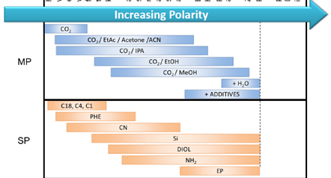
Increasing Polarity
MP
CO₂
CO₂ / EtAOc
ACE or ACN
CO2 / IPA
+ Heptane (10% max)
CO2 / EtOH
CO2 / MeOH
+ H20 (10% max)
SP
C18, C4, C1
CN
SIL
PHE
Diol
NH2
EP
Increasing Polarity
MP
Carbon Dioxide
CO₂ / Ethyl Acetate
Acetone or Acetonitrile
CO2 / Isopropyl alcohol
+ Heptane (10% max)
CO2 / Ethanol
CO2 / Methanol
+ Water (10% max)
SP
C18, C4, C1
Cyano
Silica
Phenyl
Diol
Amino
Ethyl Pyridine
Increasing Polarity
MP
Carbon Dioxide
CO₂ \ Ethyl Acetate, Acetone or Acetonitrile
CO₂ /
Isopropyl alcohol
+ Heptane
(10% max)
CO₂ /
Ethanol
CO₂ /
Methanol
+ Water
(10% max)
SP
C18, C4, C1
Cyano
Silica
Phenyl
Diol
Amino
Ethyl Pyridine
Increasing Polarity
MP
Carbon Dioxide
CO₂ \ Ethyl Acetate, Acetone or Acetonitrile
CO₂ /
Isopropyl alcohol
+ Heptane
(10% max)
CO₂ /
Ethanol
CO₂ /
Methanol
+ Water
(10% max)
SP
C18, C4, C1
Cyano
Silica
Phenyl
Diol
Amino
Ethyl Pyridine

